Slide 1
FORENSIC DENTAL X-RAY IMAGE ENHANCEMENT USING CLAHE AND FAG TO DETERMINE AGE DOMAIN: DEEP LEARNING

Slide 2
TEAM MEMBERS: Dahlia Rane P Kavya VR Nandhini S PROJECT GUIDE: Mrs P.Deepa PROJECT CO-ORDINATOR: Dr.L.Jaba Sheela

Slide 3
OVERVIEW
The first phase is related to the objective of predicting crime; consequently, the aim is to investigate several predictive models.
The last phase involves the reporting of the results of this investigation. The variations in the other phases for each experiment are presented in dental crime prediction.
In relation to the modeling phase, it typically involves building a model using some of the data available; this data is referred to as the training set.
The remaining data is used for evaluating the performance of the model (in the evaluation phase), and it is referred to as the test set. The model itself can be built using a CLAHE and FAG algorithm.
The following subsection describes the algorithms used in our experiments.

Slide 4
ABSTRACT
The increase in Forensic data recording coupled with data analytics resulted in the growth of research approaches aimed at extracting knowledge from Forensic records to better understand criminal behaviour and ultimately prevent future Forensic person identification tasks such as Forensic dental recognition.
While many of these approaches make use of clustering and association rule mining techniques, there are fewer approaches focusing on predictive models of Forensic.
In this paper we explore models for predicting the frequency of several types of dental Forensic prediction by LSOA code (Lower layer super output areas an administrative system of area for public) and the frequency of anti-social behaviour Forensic.
Two algorithms are used from different categories of approaches are CLAHE and FAG algorithm used for prediction Forensic crime and FoID maps each scan instance into an embedding.

Slide 5
LIST OF MODULES
DATA GENERATION USING BALANCING IMAGE
FORENSIC FREQUENCY PREDICTION BY CLAHE
FORENSIC FREQUENCY PREDICTION USING DENTAL IMAGE
LATENT PART LOCALIZATION
CONTRASTIVE LEARNING WITH DSA

Slide 6
TECHNOLOGY
The language used in the development is PYTHON 3.10
Windows Environment 3.3
The project is developed on i3,i5,i7 with 6 GB RAM.

Slide 7
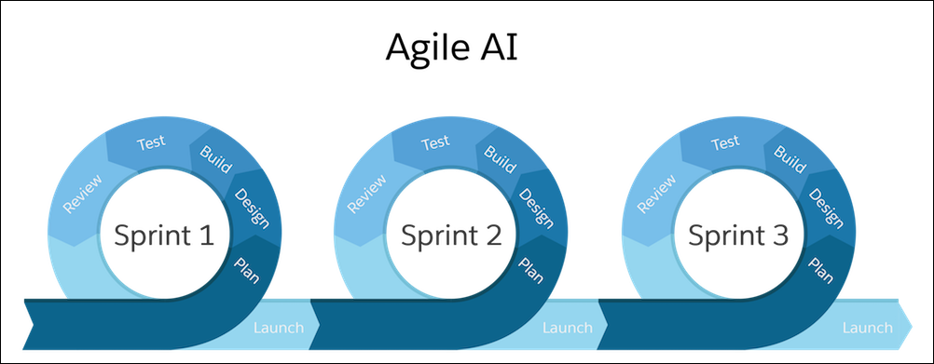
SDLC

Slide 8
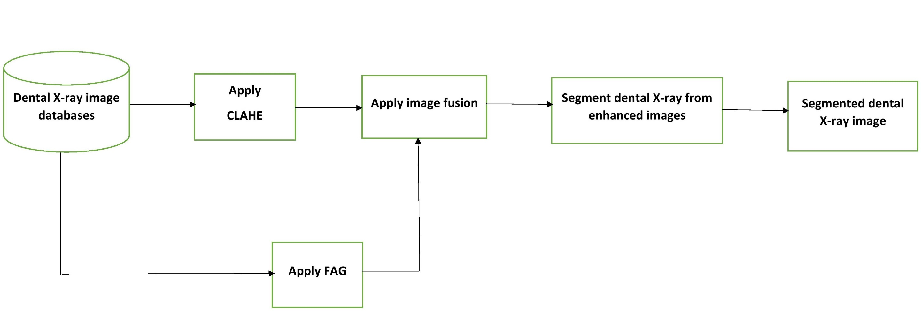
BLOCK DIAGRAM

Slide 9
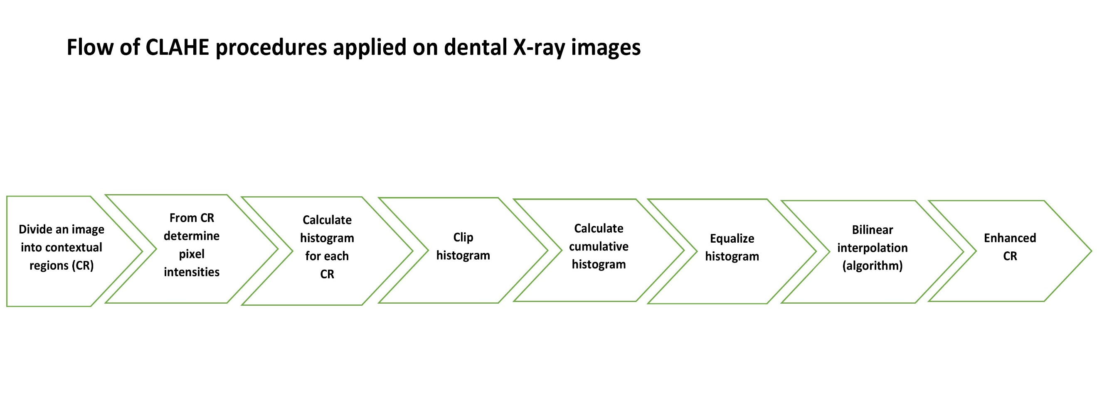

Slide 10
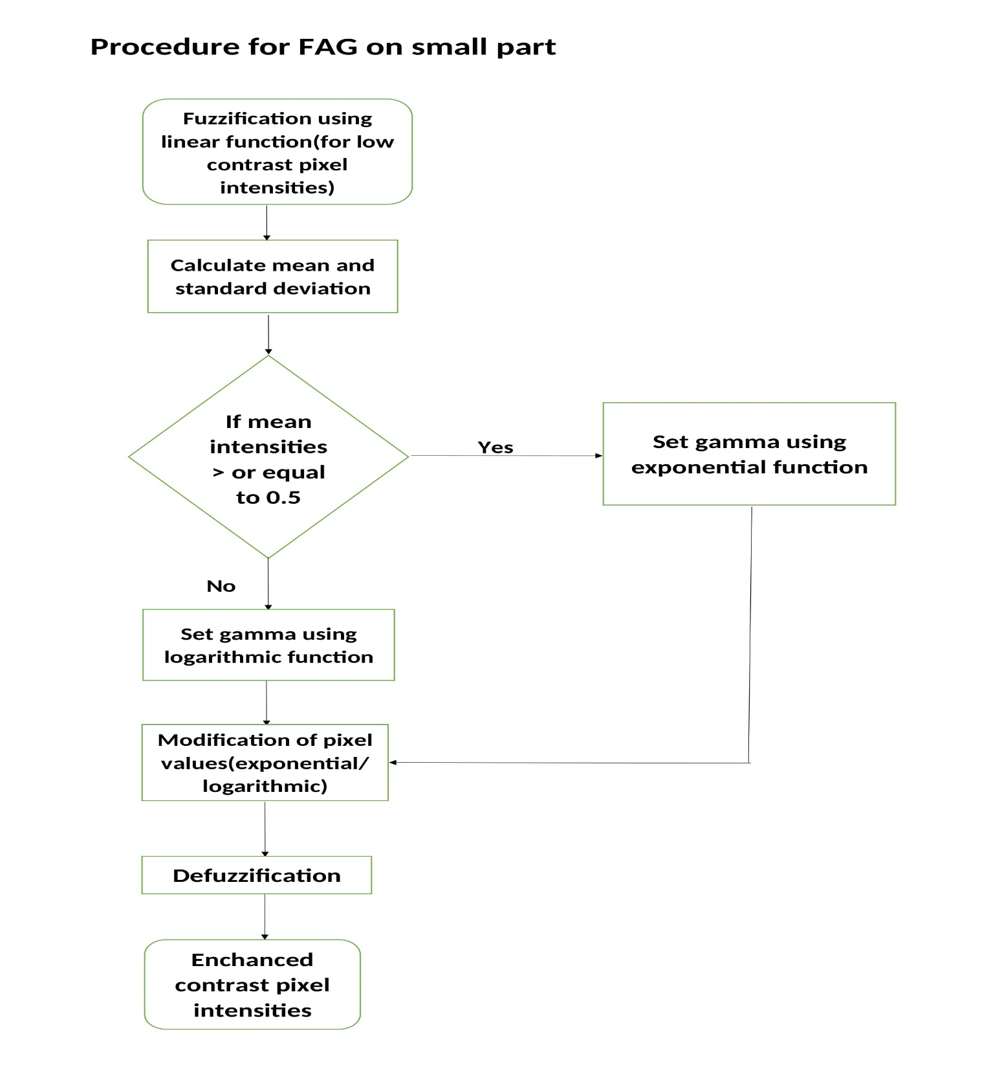

Slide 11
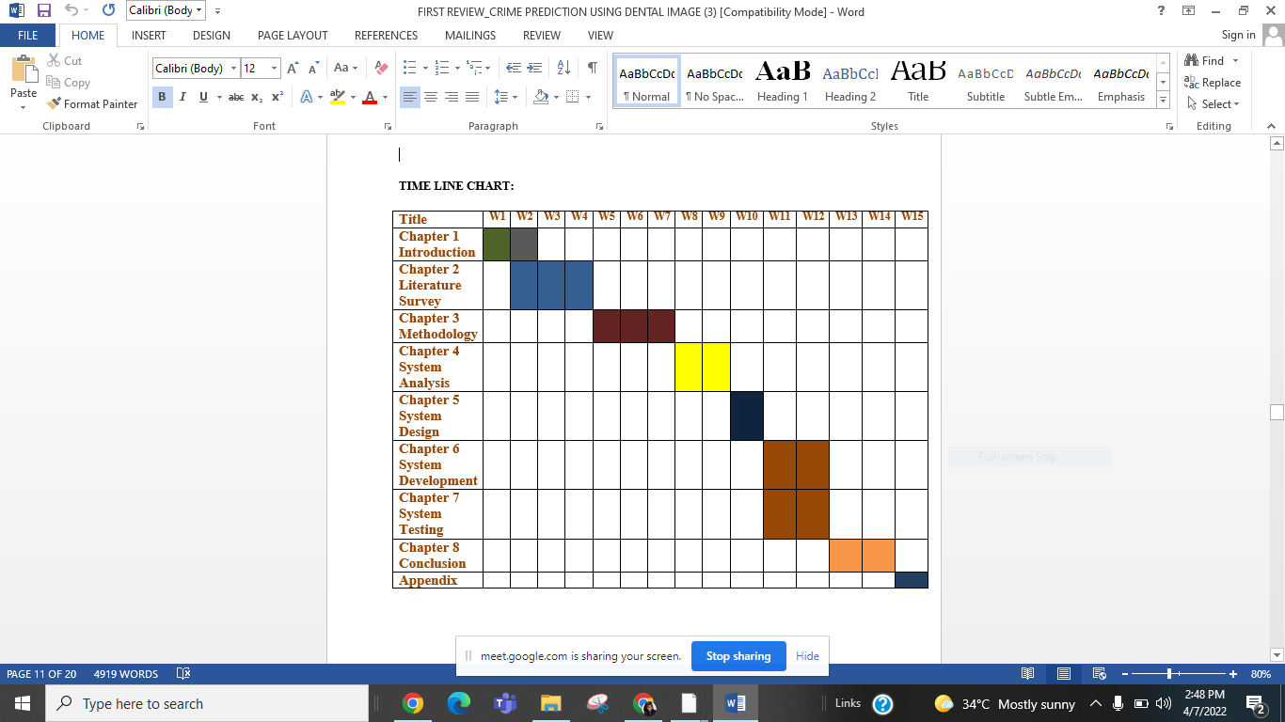
TIME LINE CHART

Slide 12
REFERENCES:
D. K. Govorko et al., "Conventional vs. Digital dental impression: practitioner’s and patient’s perspective-a pilot study," 2019 4th International Conference on Smart and Sustainable Technologies (SpliTech), 2019, pp. 1-4, doi: 10.23919/SpliTech.2019.8783139.
https://ieeexplore.ieee.org/document/8783139
A. Gurses and A. B. Oktay, "Tooth Restoration and Dental Work Detection on Panoramic Dental Images via CNN," 2020 Medical Technologies Congress (TIPTEKNO), 2020, pp. 1-4, doi: 10.1109/TIPTEKNO50054.2020.9299272.
https://ieeexplore.ieee.org/document/9299272
T. Yui, T. Ishikura, S. -G. Cho, M. Ding, J. Takamatsu and T. Ogasawara, "A Quantitative Measurement of Hand Scaling Motion for Dental Hygienist Training," 2020 42nd Annual International Conference of the IEEE Engineering in Medicine & Biology Society (EMBC), 2020, pp. 6040-6043, doi: 10.1109/EMBC44109.2020.9175617.
https://ieeexplore.ieee.org/document/9175617
G. Jaffino, A. Banumathi, U. Gurunathan and J. Prabin Jose, "Dental work extraction for different radiographic Images in human Forensic Identification," 2014 International Conference on Communication and Network Technologies, 2014, pp. 52-56, doi: 10.1109/CNT.2014.7062724.
https://ieeexplore.ieee.org/document/7062724

Slide 13
D. Verma, S. Puri, S. Prabhu and K. Smriti, "Anomaly detection in panoramic dental x-rays using a hybrid Deep Learning and Machine Learning approach," 2020 IEEE REGION 10 CONFERENCE (TENCON), 2020, pp. 263-268, doi: 10.1109/TENCON50793.2020.9293765.
https://ieeexplore.ieee.org/document/9293765
S. Divakaran, K. Vasanth, S. D and S. V, "Classification of Digital Dental X-ray Images Using Machine Learning," 2021 Seventh International conference on Bio Signals, Images, and Instrumentation (ICBSII), 2021, pp. 1-3, doi: 10.1109/ICBSII51839.2021.9445171.
https://ieeexplore.ieee.org/document/9445171
J. Bao, M. Kim, Q. Sun, A. T. Hara, G. Maupome and L. Shen, "Estimating Hard-tissue Conditions from Dental Images via Machine Learning," 2020 IEEE 20th International Conference on Bioinformatics and Bioengineering (BIBE), 2020, pp. 315-322, doi: 10.1109/BIBE50027.2020.00058.
https://ieeexplore.ieee.org/abstract/document/9288087
M. Hashem, M. L. Mohammed and A. E. Youssef, "Improving the Efficiency of Dental Implantation Process Using Guided Local Search Models and Continuous Time Neural Networks With Robotic Assistance," in IEEE Access, vol. 8, pp. 202755-202764, 2020, doi: 10.1109/ACCESS.2020.3034689.
https://ieeexplore.ieee.org/document/9244053

Slide 14
THANK YOU

